Slide 1
The importance of version control
Xing Chen

Slide 2


Slide 3

The nature of PhD projects
PhD projects are like trees:
They start out small, but grow complex, unwieldy, and out of control

Slide 4
Project planning

Slide 5
Project planning
year 5
year 6

Slide 6
Project planning
year 5
year 6

Slide 7
Data analysis
You select a method to analyse your data-
It doesn’t give the results you were expecting, and your professor says, “do …….”

Slide 8
Data analysis
You try something else…
and something else…
and something else..
till you forget what you’ve done

Slide 9
Combinatorial explosion of…
Data
Figures
Tables
Results
Analyses
Code
Statistical output

Slide 10
When it comes to writing code:
It is hard to remember what you have done
It is hard to stay disciplined enough to keep a manual record of what you have done
You will need to look through old code to retrieve data or repeat analyses

Slide 11


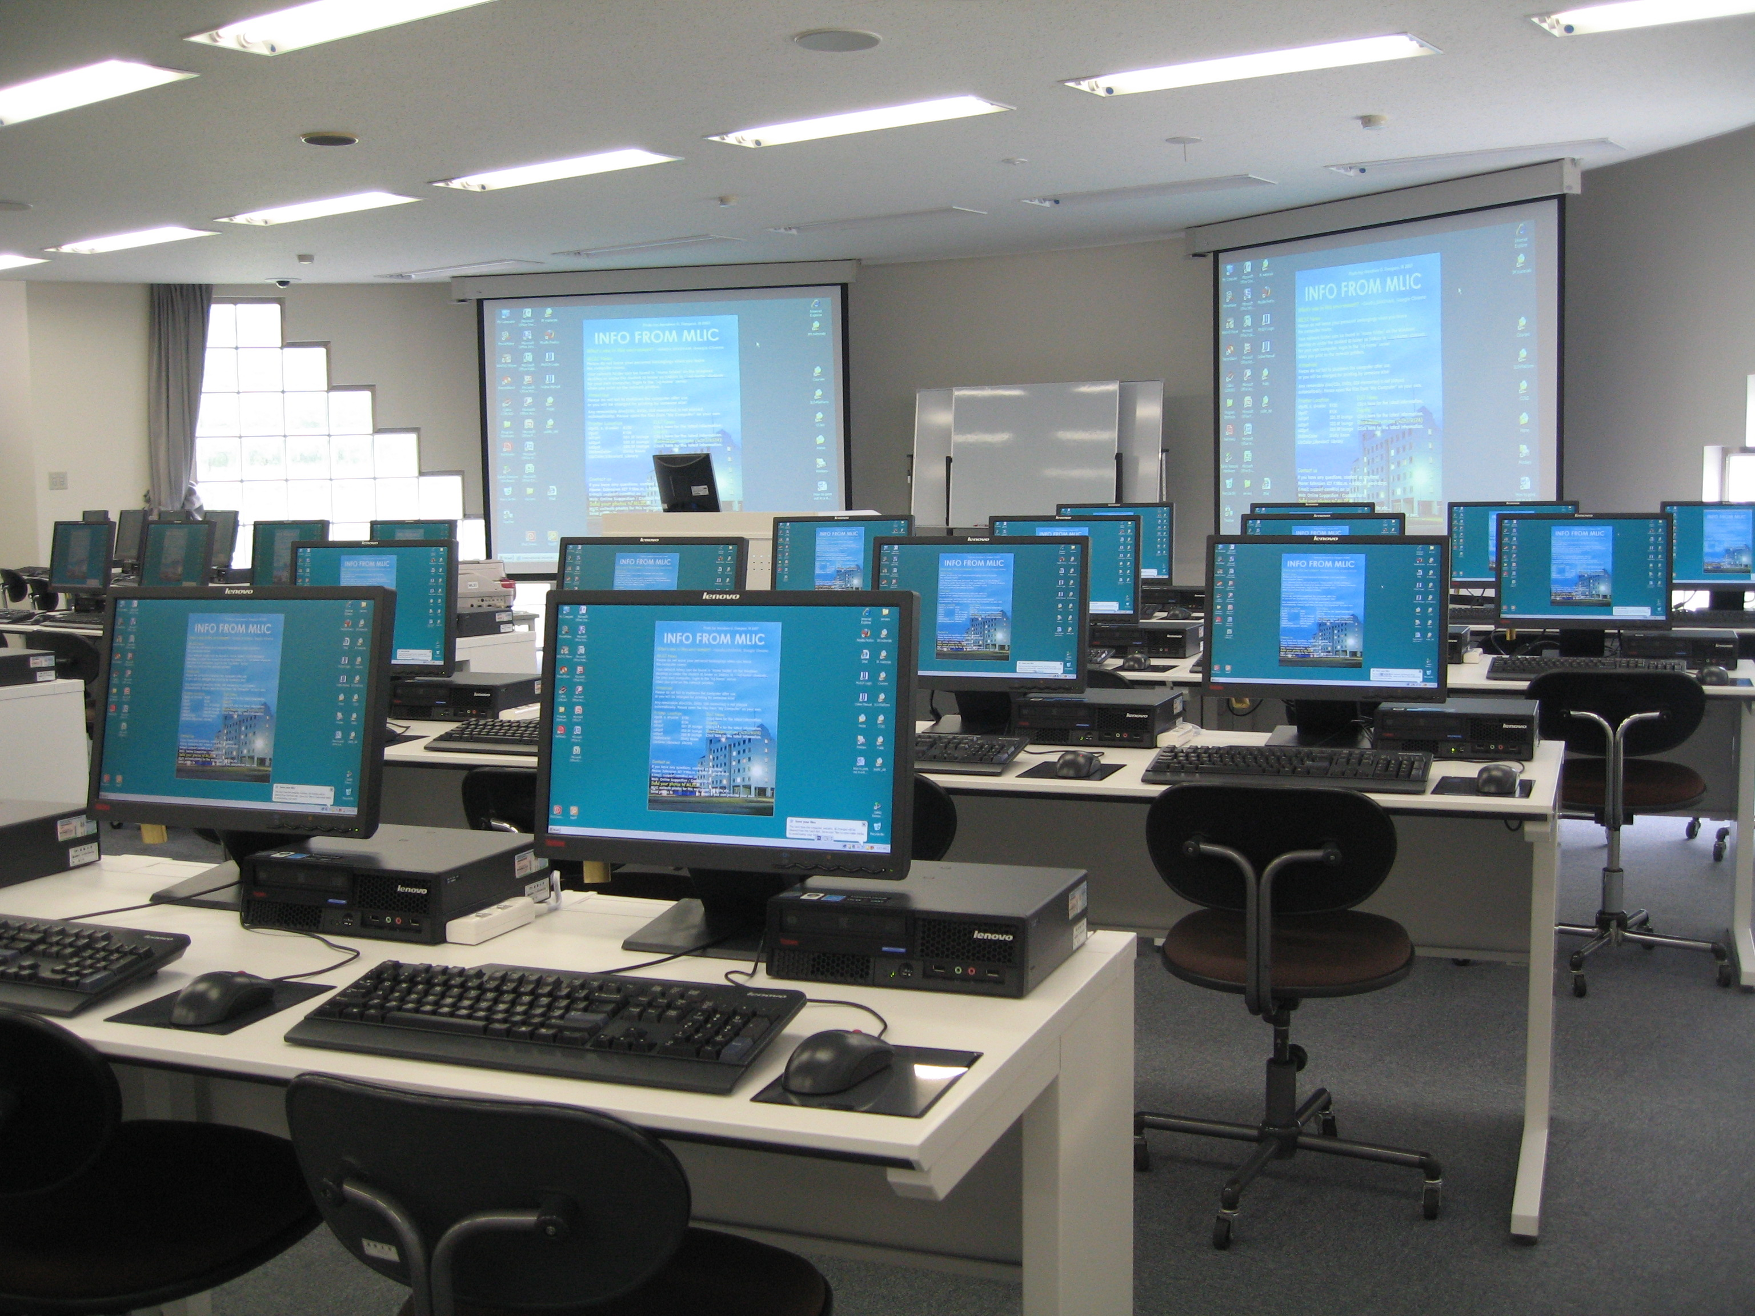

You will likely have to access your code/data from multiple locations

Slide 12

You may need to share data with collaborators, or write code together
the Cloud
Dropbox
FTP
Email
Portable storage media

Slide 13
How do I make my life easier?
This is a solved problem
Find user-friendly software tools to help you
Automate repetitive processes

Slide 14
What is a version control system?
Day 1: Did analysis X, version 1
Day 2: Did analysis X, version 1.2
Day 3: Did analysis X, version 1.3
Day 4: Did analysis Y, version 1
….

Slide 15
What is a version control system?
Day 1: Did analysis X, version 0
Day 2: Did analysis X, version 1.1
Day 3: Did analysis X, version 1.2
Day 4: Did analysis Y, version 0
….
Day 250: Did analysis F, version 10.13;
analysis K, version 2.4; analysis X, version 801

Slide 16
A VCS records changes to a file or set of files over time, so that you can recall specific versions later.
Allows you to:
View history of changes;
‘Roll back’ changes to in non-chronological order to restore previous versions;
Synchronise your files across multiple locations;
Retrieve files from duplicate repositories if some of your repositories get lost.

Slide 17
In summary
You can easily check what you did before, revert files to a previous state, review changes over time, debug problems, and more.
If you screw things up or lose files, it allows you to recover relatively painlessly.

Slide 18
Examples
Dropbox
By default, Dropbox saves all deleted and previous versions of your files for 30 days.
Possible to purchase Extended Version History:
revert to or recover a file at any time within a year of subscription.

Slide 21
Examples
AutoHistory
A plugin for MS Word 2010 that makes automatic backups of your documents at preset intervals.
If you are working on very large documents (e.g. a thesis), it may interrupt your work flow for a few seconds while it saves the file, but it can be very helpful in the event that your computer crashes.

Slide 22
Examples
MS Word Autosave versions

Slide 23
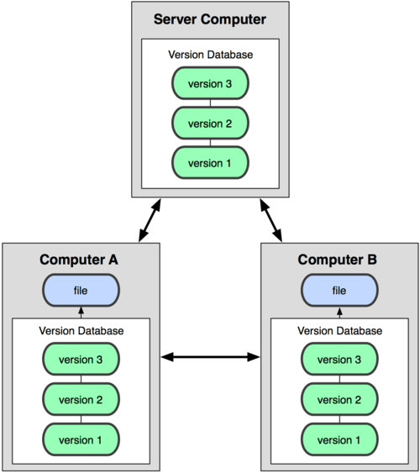
A distributed version control system

Slide 24
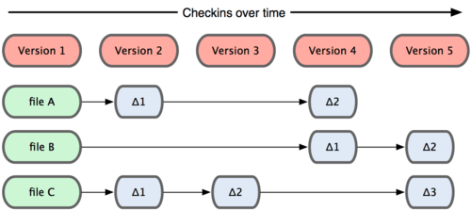
Snapshots of your code
Method 1: Keep track of changes

Slide 25
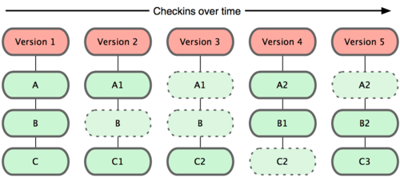
Snapshots of your code
Method 2: Keep track of complete picture at any given time

Slide 26
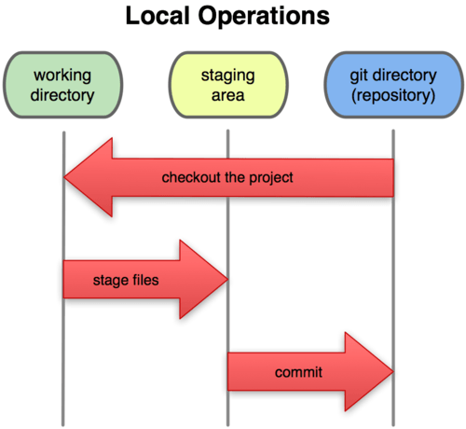
Example of how VCS works

Slide 27
The basic workflow
Modify files in your working directory.
‘Stage’ the files, adding snapshots of them to your staging area.
Make a commit: take a snapshot of the files in the staging area and store that snapshot permanently in your records.

Slide 28
Example VCS: Git
Set up a ‘repository’: Store your code in a designated set of folders.
The Git software automatically keeps track of all the files within the selected folders (like Dropbox folders).

Slide 29
Example VCS: Git
Set up a ‘repository’: Store your code in a designated set of folders.
The Git software automatically keeps track of all the files within the selected folders (like Dropbox folders).

Slide 30
Example VCS: Git
Each time you make a ‘commit’ to your repository, you are provided with a comment box, into which you can enter your reasons for making your modifications.
When you make modifications to your code, you can view the modified and the original versions side by side.

Slide 31
Example VCS: Git
Each time you make a ‘commit’ to your repository, you are provided with a comment box, into which you can enter your reasons for making your modifications.

Slide 32
Example VCS: Git
If you want to retrieve a previous version, you can:
‘Roll back’ your edits;
Download the previous version and save it under a different name;
Compare the pieces of code by eye and make your changes manually.

Slide 33
Example VCS: Git
If you want to retrieve a previous version, you can:
‘Roll back’ your edits;
Download the previous version and save it under a different name;
Compare the pieces of code by eye and make your changes manually.

Slide 34
Branching
VCS software allows you/your collaborators to create branches and work separately, before merging your branches.
Useful when a piece of code needs to be modified simultaneously.
E.g. you might have a working piece of code, but still be trying to improve it. Your newer code is in a limbo state- not quite working and reliable yet.

Slide 35
Maybe you need your original version in the interim, or your collaborator is modifying the original version.
By creating a ‘branch,’ you can modify it in peace and quiet, while other analyses are run using the previous version.
Then, once you have sorted the bugs out and modified the new branch to your satisfaction, you can merge the branches.

Slide 36
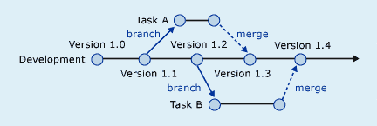
Branching

